Slide 2

WEEKLY REPORT
WEEK 5 – ICN TRAINING
NGUYEN HAI DANG

Slide 3
What I have done this week
Review the difference between sigmoid and tanh as activation functions.
Review the hinge loss function.
Construct a basic neural network.
Learn about Convolutional neural networks.

Slide 4
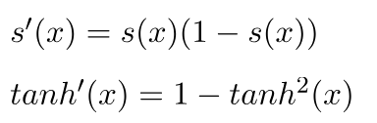
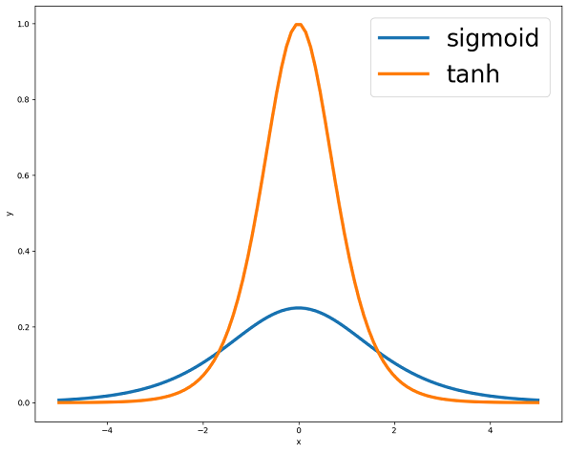
I. Sigmoid and tanh difference
- The tanh has a bigger derivative than sigmoid, which helps to deal with the “vanishing gradient” problem a little bit better.
- Tanh is symmetric about 0, leading to faster learning and convergence.
Therefore, most of the time, Tanh is favored over sigmoid.

Slide 5
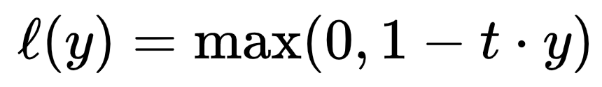
II. Hinge loss function
Well-suited for binary classification problems and for optimizing support vector machine (SVM) models.
Effective for optimizing a decision boundary for separating two classes.
t: intended output (-1 if correctly classified or 1 otherwise)
y: raw model output
The outcome is always non-negative. If 1-t.y is negative i.e. t and y are the same sign (correct class prediction), the loss is defined as 0.
Hinge loss is almost everywhere differentiable (except where t.y = 1, at which we assume its derivative to be 0)

Slide 6

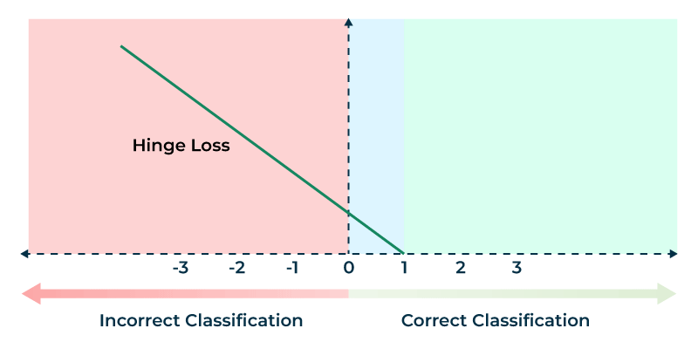

The further away a misclassified point is from the margin, the more penalty it causes for the model

Slide 7
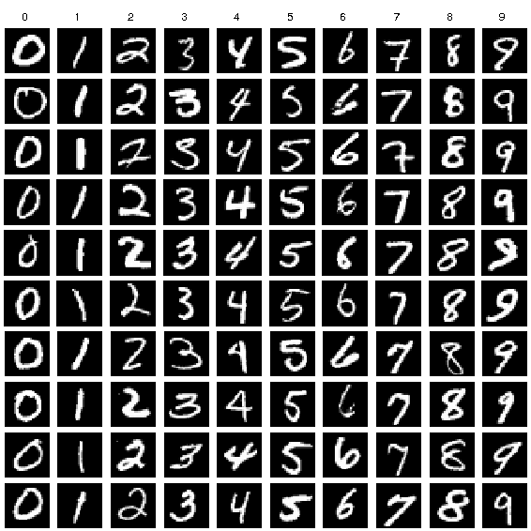
III. Neural network implementation on MNIST dataset
The MNIST dataset
- A database of 60,000 samples, each being a 28x28 pixel image of a handwritten digit between 0 and 9.
For this instance, we will take around 42,000 samples and split it into a training set of 41,000 samples and a test set of 1,000 samples
The neural network is expected to correctly predict the label of a sample, given its pixel values.

Slide 8
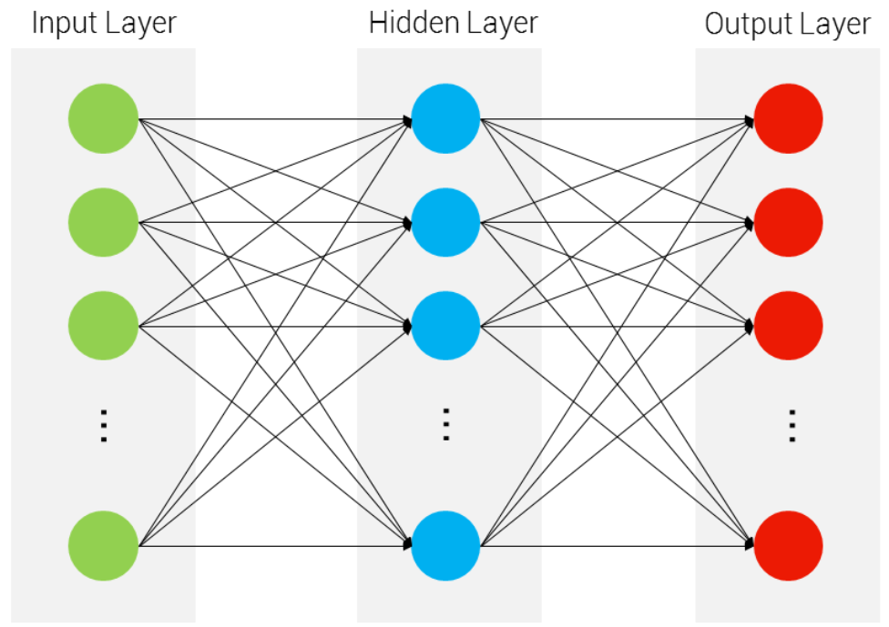
III. Neural network implementation on MNIST dataset
We will construct a two-layer neural network:
784
10
ReLU
10
Softmax

Slide 9
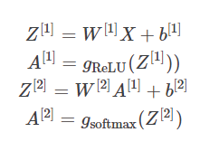
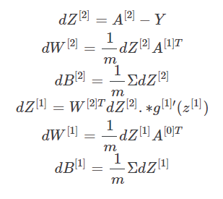
III. Neural network implementation on MNIST dataset
Forward propagation:
Backpropagation:

Slide 10
IV. Convolutional neural network (CNN)
Concept
A type of neural network specialized for handling visual inputs.
We use CNNs to deal with the problem of large data samples (e.g. a 64*64 image has 64*64*3 = 12288 pixels, if multiplied by the number of layers, nodes can cause the number of parameters to grow excessively large)
CNN solves this by using dimensionality reduction and only retaining patterns within the image, thus reducing its size.
CNN has the following structure:
Input – Convolutional layer + Pooling layer – Fully connected layer - Output

Slide 11
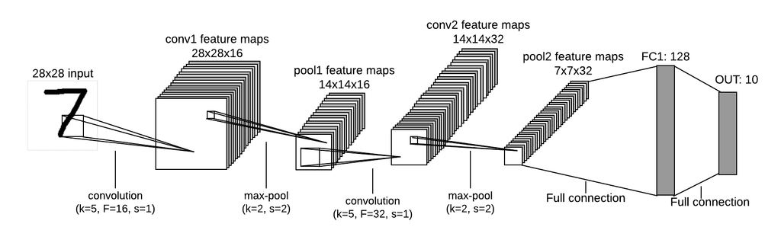
IV. Convolutional neural network (CNN)
An example of a CNN model
k: kernel size
F: number of filters (kernels)
s: stride

Slide 12
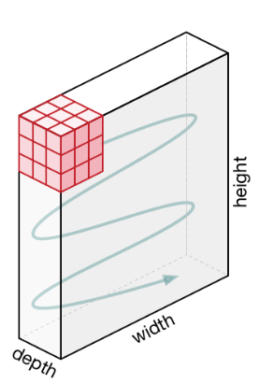
IV. Convolutional neural network (CNN)
Structure
Convolutional layer: Takes a 3D tensor input – height*width*depth (e.g. 28*28*3)

Slide 13
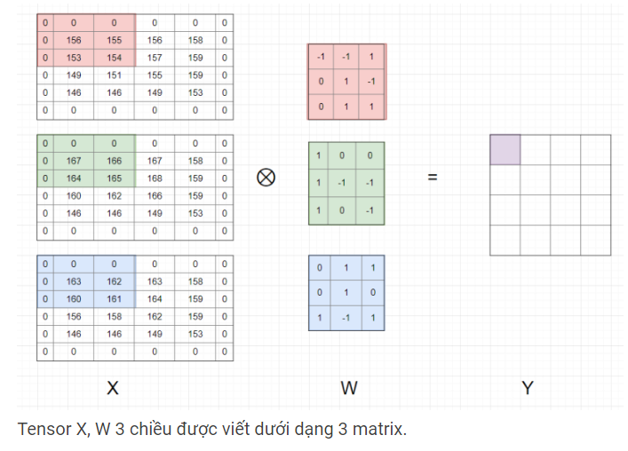
IV. Convolutional neural network (CNN)

Slide 14
IV. Convolutional neural network (CNN)
The output (Y) of the convolution is a matrix, which is then fed into the next convolutional layer.

Slide 15
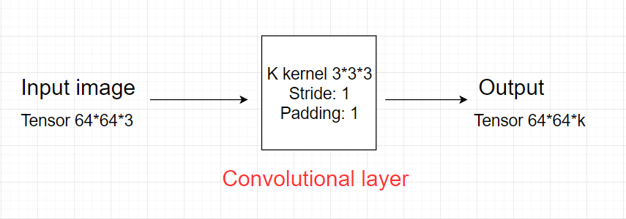
IV. Convolutional neural network (CNN)
Each kernel learns a specific pattern of the image
k kernels returns k output matrices
Ultimately, we combine the output matrices into a 3D tensor with depth k

Slide 16
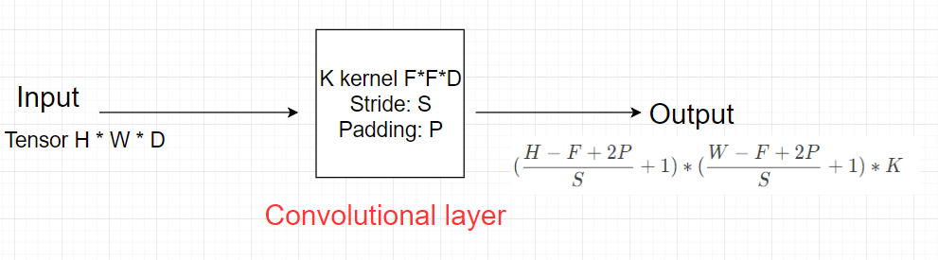
IV. Convolutional neural network (CNN)
A general convolutional layer
Kernel has size F*F*D (F is an odd number, D – depth)

Slide 17
IV. Convolutional neural network (CNN)
Pooling layer: Used between convolutional layers to reduce dimensions while retaining important features
Input: Let the pooling size be K*K. A tensor of size H*W*D, which we break up into D matrices of size H*W. For each matrix, we find the max or average of K*K submatrices and write them into the output matrix.
Normally, we use pooling layer of size 2*2,
Stride = 2, padding = 0
Output width and height is halved;
Depth remains the same

Slide 18
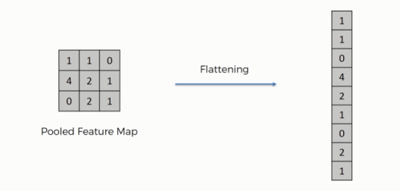
IV. Convolutional neural network (CNN)
Fully connected layer: After the input goes through a set number of convolution + pooling layers, we change the last tensor output into a vector and feed it into the fully connected layer to gain the final output of the model.

Slide 19
THANK YOU !

